Slide 1


SUPPLY
CHAIN
REPORT ANALYTICS & DASHBOARDS
GROUP 4

Slide 2

Agenda
01
Introduction
05
Tableau Dashboard
02
Project Summary
06
PowerBI Dashboard
03
KPI List
07
SQL
04
Excel Dashboard
04
Key Takeaways

Slide 3


Team
Members
Abhishek Upadhyay
Rutika Pawar
Ashutosh Mishra
Kruthika Beatrix

Slide 4

Project Summary
Supply chain management involves overseeing the flow of goods, services, and information from raw material suppliers to end consumers. It aims to optimize efficiency, minimize costs, and ensure timely delivery through processes such as procurement, production, logistics, and distribution, fostering collaboration among all parties involved.
Our project aims to enhance supply chain efficiency through improved warehouse management and inventory processes.
By developing comprehensive report analytics and interactive dashboard analytics, we provide stakeholders with actionable insights and real-time data to make informed decisions.

Slide 5

Total Sales (MTD, QTD, YTD): Tracks sales on a Monthly-to-Date, Quarter-to-Date, and Year-to-Date basis.
Product Wise Sales: Analyzes sales data by individual products.
Sales Growth: Measures the percentage increase in sales over specified periods.
Daily Sales Trend: Tracks sales on a daily basis.
State Wise Sales: Breakdown of sales data by state.
Top 5 Store Wise Sales: Identifies the top 5 performing stores based on sales figures.
Region Wise Sales: Analyzes sales data by broader regions.
Total Inventory: Tracks the total amount of inventory on hand.
Inventory Value: Calculates the total monetary value of inventory.
Overstock, Out Stock, Under Stock: Monitors inventory levels to identify overstocked, out-of-stock, and understocked items.
Key
Performance
Indicators (KPIs)

Slide 6
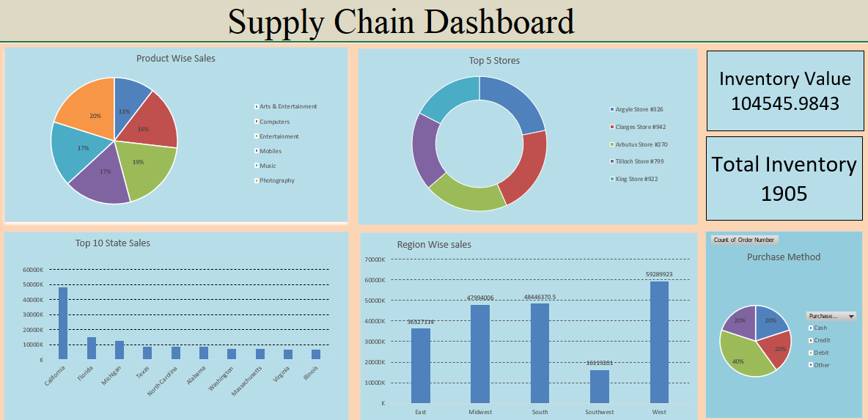
Excel Dashboard

Slide 7
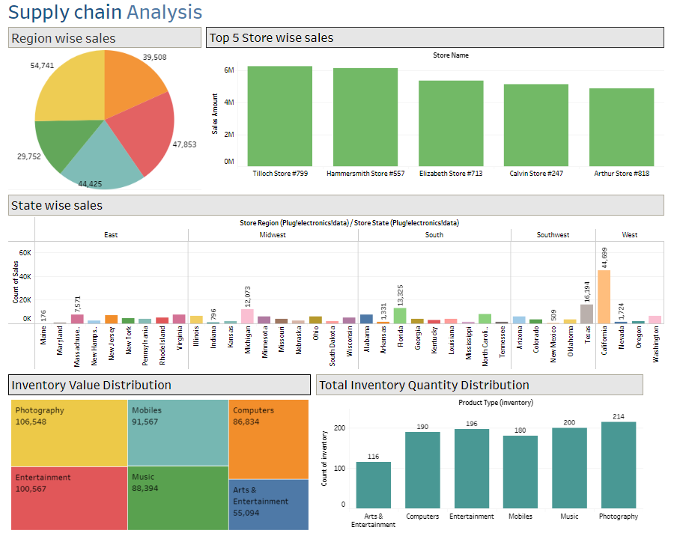
Tableau Dashboard

Slide 8
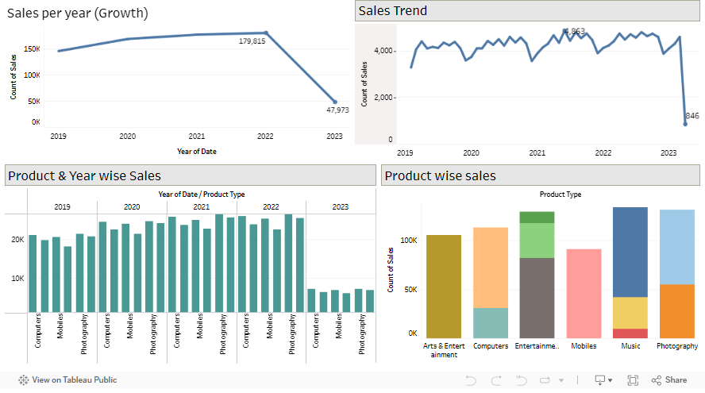
Tableau Dashboard

Slide 9
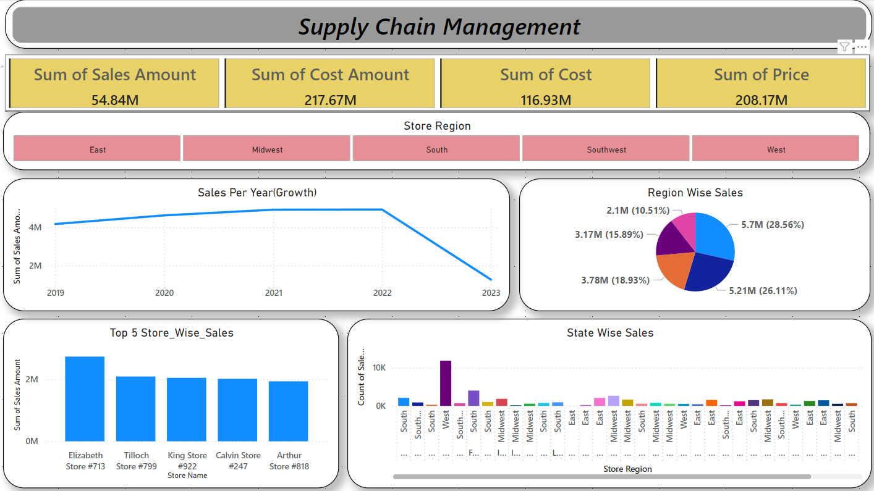
PowerBI Dashboard

Slide 10
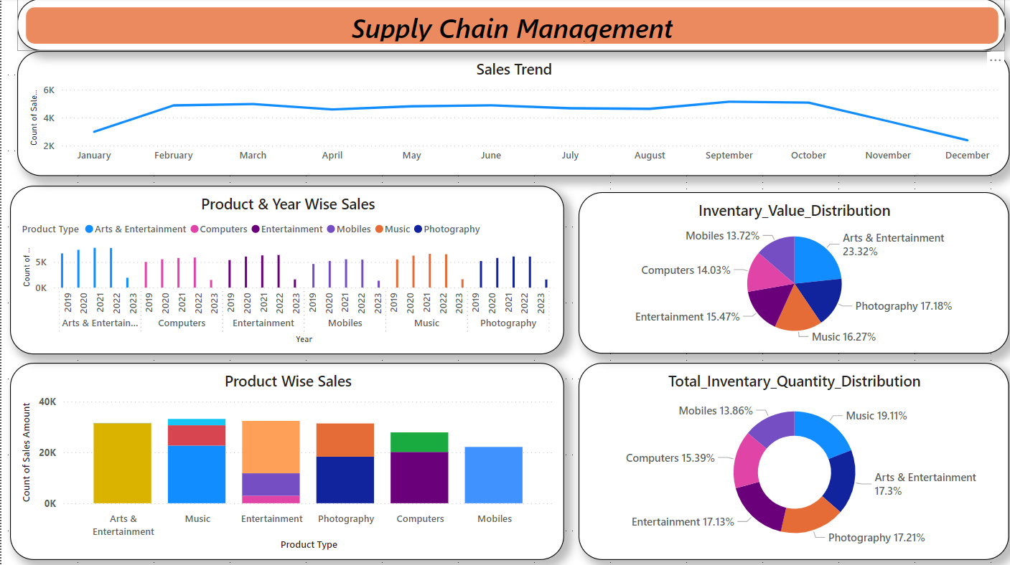
PowerBI Dashboard

Slide 11

Key
Optimize Warehouse Management: Streamline operations to reduce costs and improve accuracy.
Enhance Inventory Processes: Ensure stock accuracy and balance to prevent shortages and excess.
Develop Report Analytics: Generate actionable insights and track performance effectively.
Implement Dashboard Analytics: Provide real-time visibility and easy access to key metrics.
Takeaways

Slide 12
THANK
YOU

